Slide 1
Link to Git
https://git.informatik.uni-hamburg.de/2wrobel/whisper4all_projektai

Slide 2
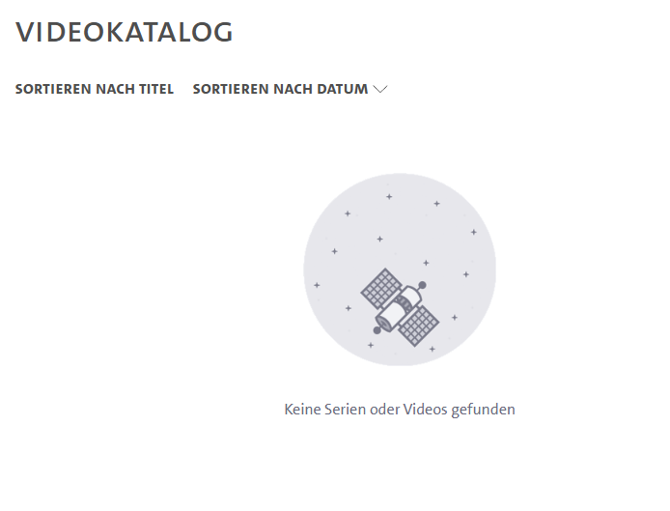

Problem

Slide 3

Whisper4all
VOICE CONTROLLED LECTURE2GO SEARCHING
Gregor Stange
Torben Hannemann
Simon Kazemi
Frank Hammerschmidt
Viktoria Wrobel
Project supervisor: Robert Geislinger

Slide 4
Agenda
The Start
Goals
Frontend
Backend
Integration
Architecture
Challenges
Result

Slide 5
The start
input from Robert
creation of Figma Sketches, Prototyp
answering open questions
work distribution

Slide 6

goals
▪ navigate lectures using voice commands
▪ improved accessibility
▪ fast access to specific lecture topics
▪ reduced time spent searching for content manually

Slide 7

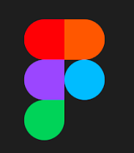


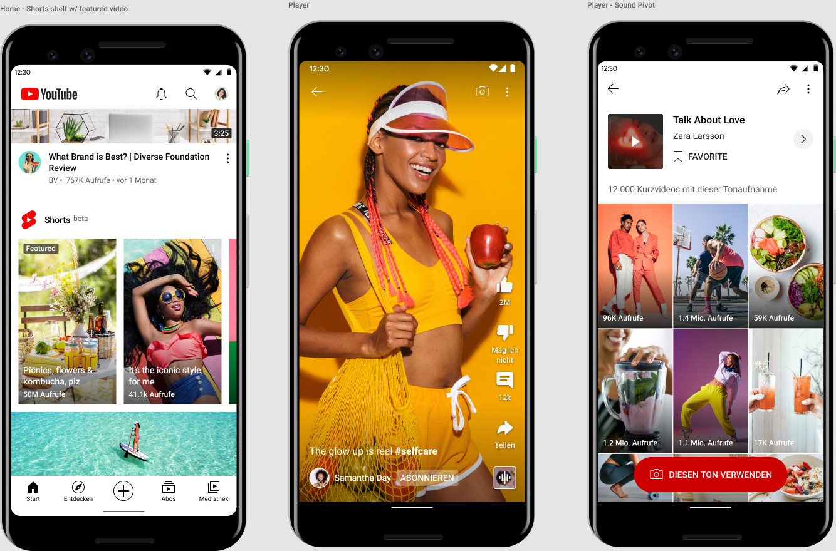
Frontend
Figma
Bootstrap
Flask
Vanilla JS
Shorts

Slide 8
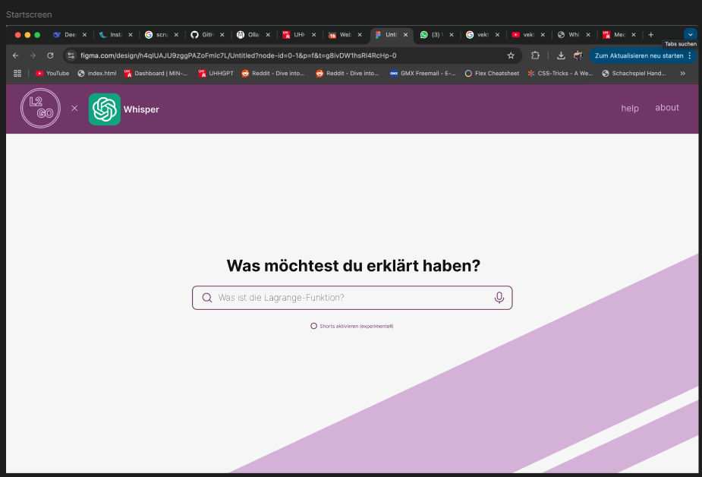

Slide 9
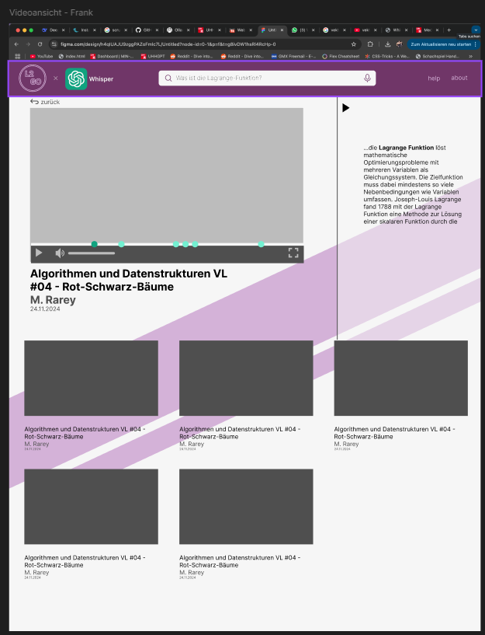
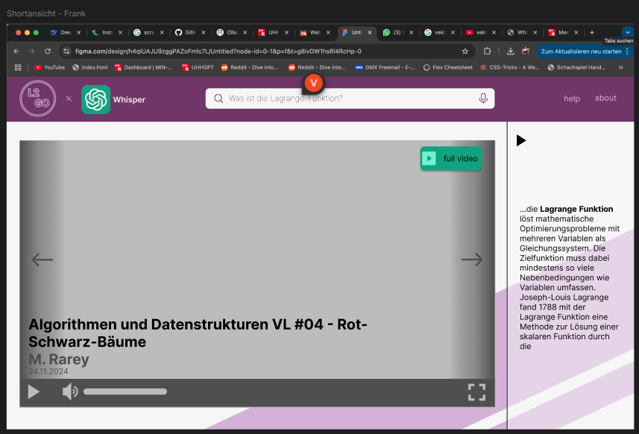

Slide 10


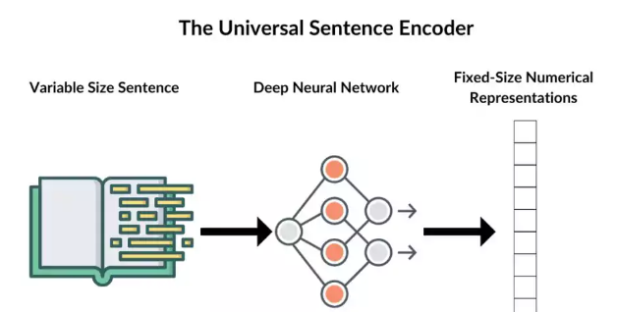
Backend
Whisper Timestamped
ChromaDB
USE Multilingual
Python
Flask

Slide 11


Integration
Flask
JSON
Docker

Slide 12
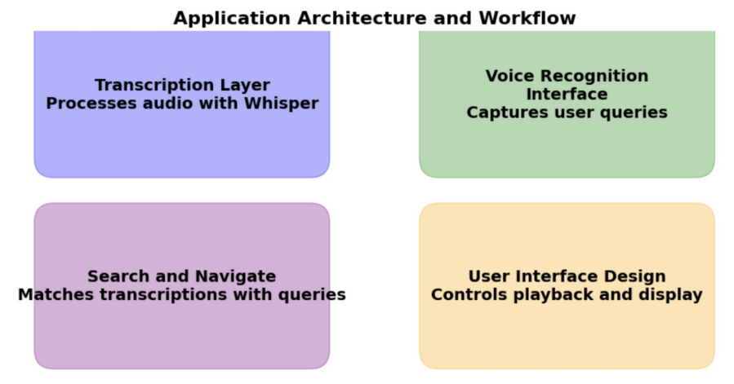
Architecture

Slide 13
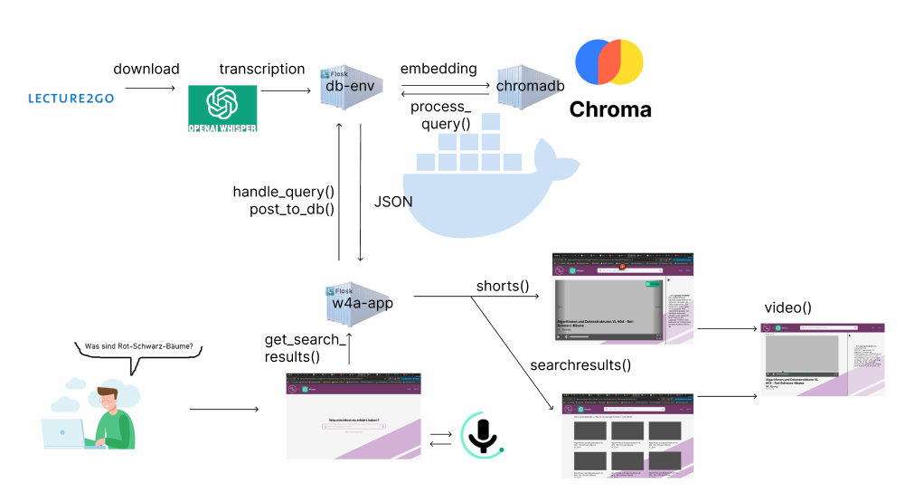
Architecture

Slide 14

Challenges

Slide 15
Challenges
& Takeaway
difficult integration
run Whisper locally
Docker is a mystery
JS framework would have been good
excellent team work
Flask is wonderful
Docker is a bit less of a mystery
better idea of project based work
Bootstrap is useful

Slide 16

Result & Future

Slide 17
Result
& future
running prototype
user-friendly interface
seamless integration
working shorts view
two database requests
integration in L2G?
model improvements
Firefox compatibility

Slide 18

Thank you
Questions?

